Slide 1
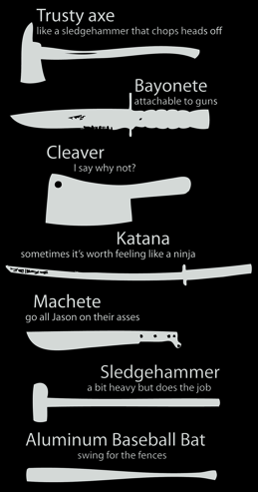
Game Jam Survival Guide

Slide 2


Who‘s that guy?
@badlogicgames

Slide 3
Preparation? What Preparation?
Choose your tools!
Engine, framework, library
Programming language, IDE
Audio editors & generators
Graphics editors
Map editors
Use what you already know!

Slide 4
Let‘s have a look at some engines, frameworks, libraries*
*Ones i‘ve used. Don‘t be religious!

Slide 5

Engines
Pros
Every platform under the sun
2D & 3D
WYSIWYG editor
Asset store*
C#, JavaScript, Boo
Cons
May be overkill for 2D
2D workflow still a bit wonky
Harder to work efficiently in a team
HTML5 exports huge/experimental
* Check game jam rules on using 3rd party assets!

Slide 6

Engines
Pros
Desktop, mobile, HTML5
2D & 3D
WYSIWYG editor
Blueprints, C++
Cons
May be overkill for 2D
2D workflow not ideal
HTML5 exports huge/experimental
C++ if Blueprints isn‘t sufficient

Slide 7

Engines
Pros
Desktop, mobile, HTML5
2D
WYSIWYG editor
Game Maker language
Cons
Custom scripting language
Can feel very limiting
Free edition only allows export to Windows

Slide 8
Frameworks
Pros
Desktop, mobile, HTML5
2D & 3D
Java, Scala, Kotlin, ...
Documentation
Very modular & flexible
Cons
HTML5 export only works for Java
Users need Java installed for desktop builds
No official WYSIWYG editor*
3D not as powerful as Unity/Unreal
No asset pipeline, DIY
*Check out Overlap2D!

Slide 9

Frameworks
Pros
Desktop, mobile, consoles*
2D & 3D
C#, F#
Derrived from XNA
Cons
No HTML5 export
Users need .NET/Mono installed to run desktop builds
No WYSIWYG editor
3D not as powerful as Unity/Unreal
Asset pipeline can be hinderance
*With some caveats

Slide 10

Frameworks
Pros
Desktop, mobile*
2D
Lua
Great API
Builds native executables
Cons
No HTML5 export
No WYSIWYG editor
Debugging support is not as strong
*Experimental

Slide 11

Libraries
Pros
Desktop, mobile, HTML5*
2D
C or anything that binds to C
Minimal API
Cons
You‘ll have to reinvent a lot of wheels
No built-in support for common things like tilemaps, fonts etc.
Performance can be a problem if you don‘t use it with OpenGL
*Via emscripten

Slide 12

How to pick?
Most important
Do i know it already?
Do my teammates know it?
Is it the tool i‘m fastest with?
Bonus
Does it fit my budget?
Does it export to HTML5?
If you didn‘t use it before the jam, don‘t use it during the jam!

Slide 13
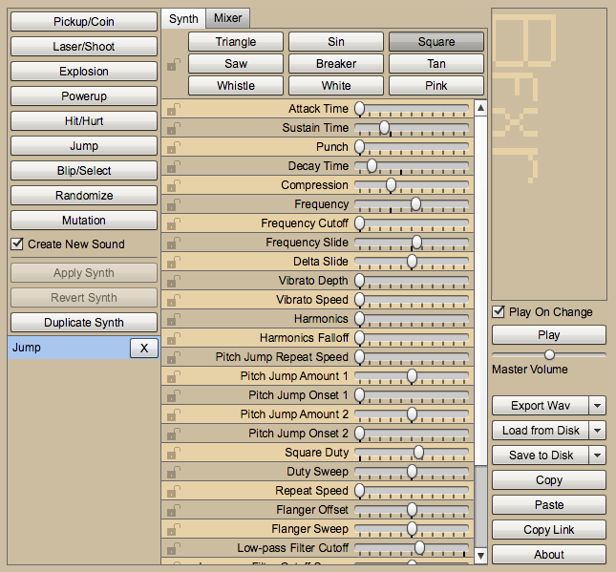
Audio Tools & Resources
http://www.bfxr.net/

Slide 14
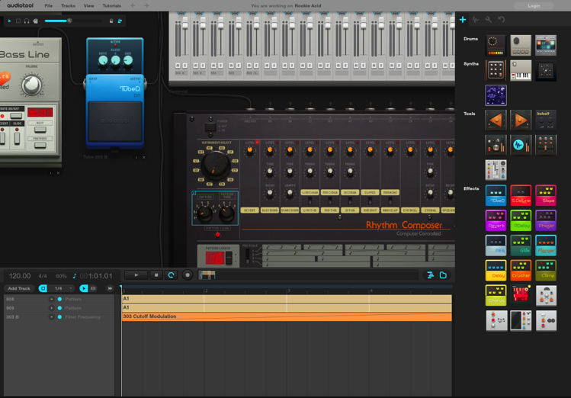
Audio Tools & Resources
http://www.audiotool.com

Slide 15
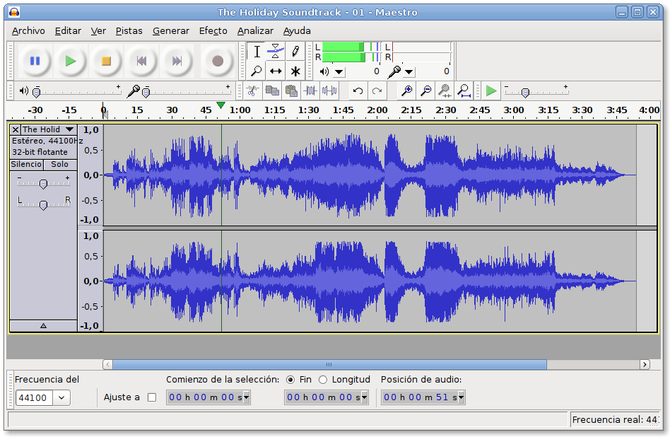
Audio Tools & Resources
http://audacity.sourceforge.net/

Slide 16
Audio Tools & Resources
Free Soundeffects & Music*
https://www.freesound.org/
https://soundcloud.com/ (CC Group)
http://openmusicarchive.org/
http://dig.ccmixter.org/
http://www.indiegamemusic.com/
*Always check Jam rules

Slide 17
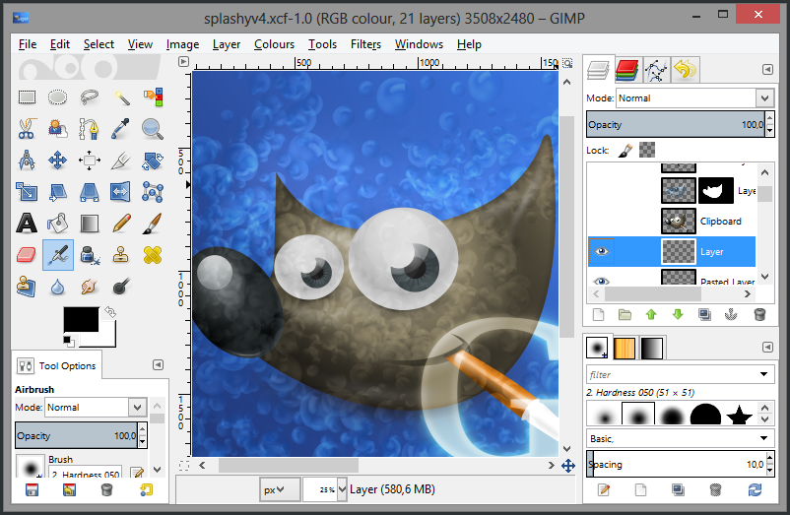
Graphics Tools & Resources
http://www.gimp.org/

Slide 18
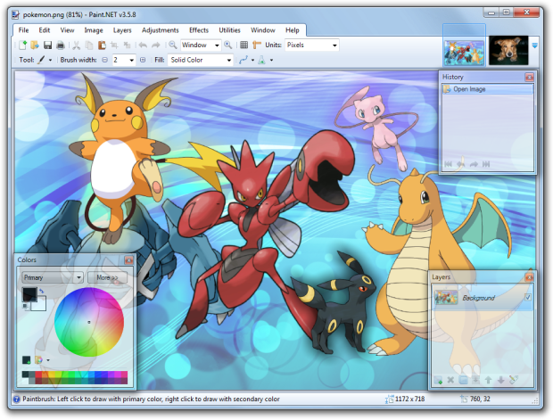
Graphics Tools & Resources
http://www.getpaint.net/index.html

Slide 19
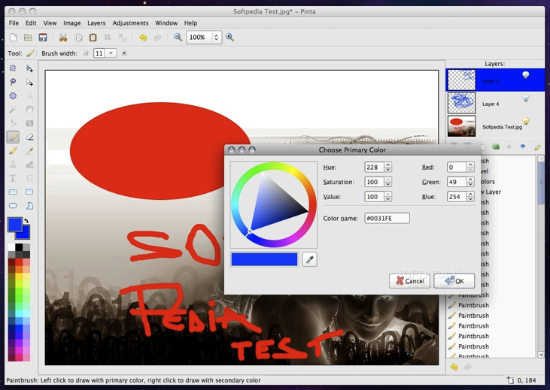
Graphics Tools & Resources
http://pinta-project.com/releases

Slide 20
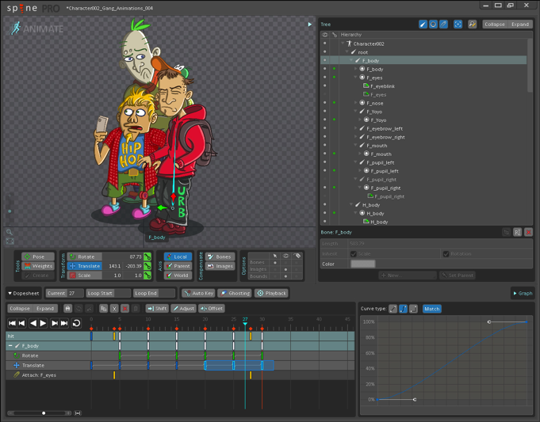
Graphics Tools & Resources
http://esotericsoftware.com/

Slide 21
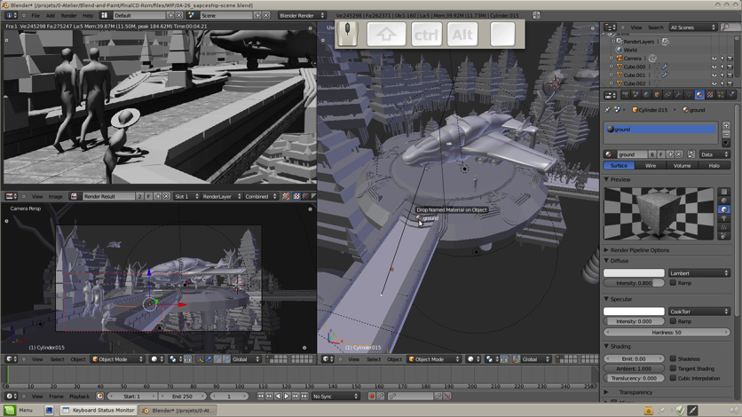
Graphics Tools & Resources
http://www.blender3d.org/

Slide 22
Graphics Tools & Resources
Free Game Art*
http://opengameart.org
http://kenney.nl
http://www.lostgarden.com
http://www.gameart2d.com
*Always check Jam rules

Slide 23
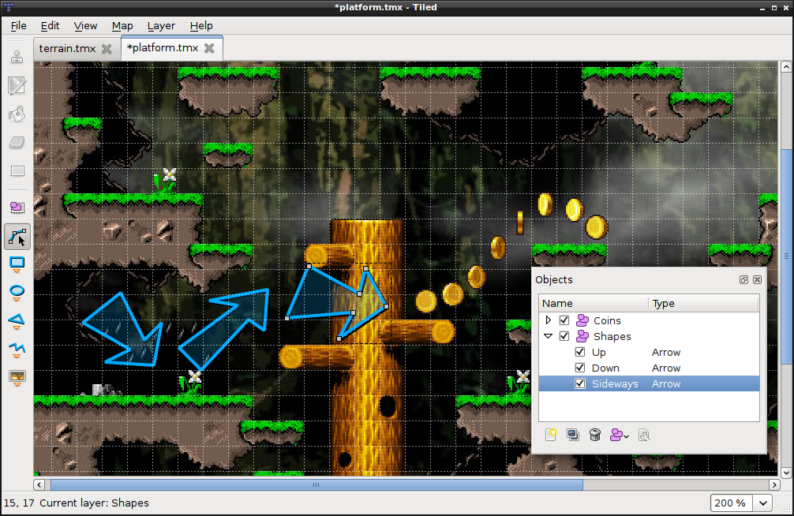
Map Editors
http://www.mapeditor.org/

Slide 24
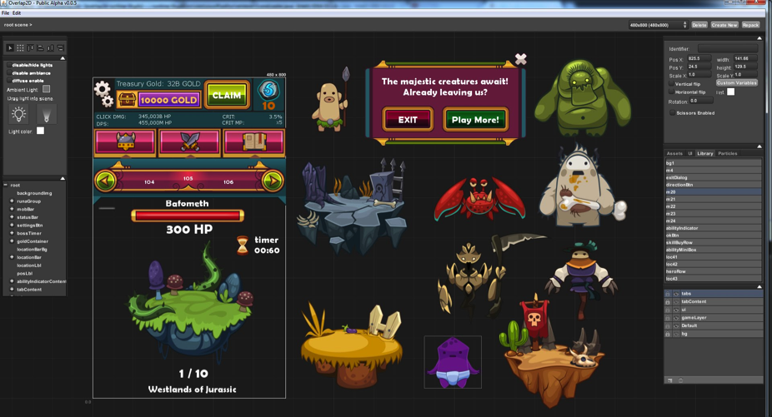
Map Editors
http://overlap2d.com/

Slide 25
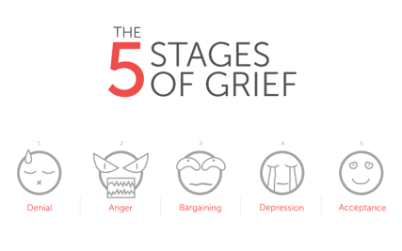
The 5 Phases of Jamming
Team Building
Brainstroming
Setup
Implementation
Finishing Touches

Slide 26
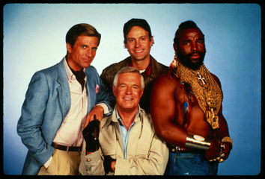
Team Building
You will need
Developers
Audio & graphics artists*
Game/level designers
Coordinator
The latter two can be done by
anyone!
*Rare unicorns

Slide 27
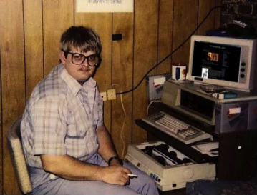
Team Building
Developers
Do the programmy bits
Need to split up tasks among them
Graphics, Controls, Physics, UI, ...
The less overlap code-wise the easier!
Need to tell artists what formats they need
Need to define how game/level designer creates content

Slide 28
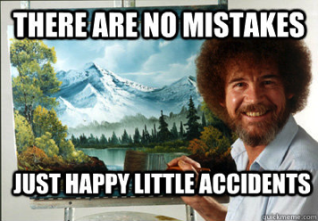
Team Building
Graphics & Audio Artists
Do the artsy bits
Need to split up tasks among them
UI, background, characters, effects, ...
Need to agree on an art style
May need to create placeholder art early on

Slide 29
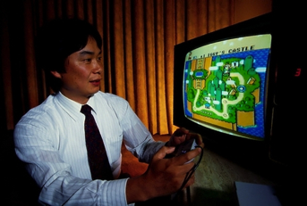
Team Building
Game/Level Designer
Does the content bits
Needs to define the game mechanics
Needs to define the game progression
Needs to create „levels“
Needs to playtest and give feedback to devs and artists

Slide 30

Team Building
Coordinator
Makes sure everyone knows what to do
Keeps track of things to be done
Keeps track of dependencies between team members
Keeps track of time
Keeps track of human needs (food, sleep)

Slide 31
Team Building
If you have no developers, look into Construct 2
If you have no artists, use preexisting art or programmer art
If you have no game designer, everybody becomes a game designer
If you have no coordinator, pick one person
If you are alone, you get to do all the things :D

Slide 32
Brainstorming
Goals
Get a high-level understanding of your game
Genre
Game mechanic
Setting & Story
Art style
Take time limits into account
FPS, MMORGP, RTS are likely not your best bets
Think outside the box! (hurr durr...)

Slide 33
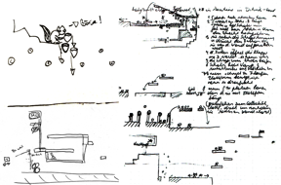
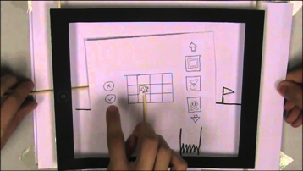
Brainstorming
To-do
Gather ideas from everyone
Pick most promising one via vote
Define genre & game mechanics
- Use pen & paper!
Define setting & story
Define art style
- Let artists draw quick mockups
Don‘t be afraid to throw things away
Don‘t be afraid to iterate, take your time

Slide 34
Setup
Goals
Get a detailed understanding of your game
What will the developers have to do?
What will the artists have to do?
What will the game designers have to do?
Define interfaces between all team members
How do developers work with each other?
How do artists get their art into the game?
How do game designers create game content?
Define tasks and their order for every team member!
Coordinator responsible for keeping track of tasks

Slide 35
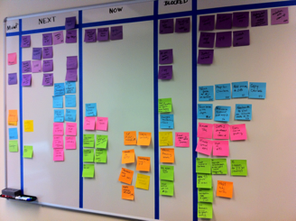
Setup
To-do
Developers agree on platform & tools to use
Artists agree on artstyle
Developers and artists agree on how to get art into the game
Developers and game designer agree on how to create content
Each subteam defines their initial tasks
Coordinator keeps track of things
A super lightweight Kanban-like board can help

Slide 36
Implementation
Goals
Get the damned game done!
Ensure to have a playable prototype early
Prioritize tasks accordingly
Game mechanics first to see if they are fun!
Realize you‘ll likely not get everything done!
Which is why you should have something playable at almost all times
Cut corners, kill features, focus on the core of your game

Slide 37
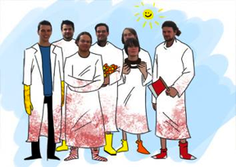
Implementation
To-do
Every sub-team works on their task
Coordinator keeps track of progress
Sub-teams talk whenever they need to (re-)define and prioritize (new) tasks
Goto 1
Your highest priority should be to have something playable early on!

Slide 38
Implementation
Tips for Developers
Use source control (git, SVN), do NOT use shared drives, ZIP files, e-mail!
Don‘t code for re-use
Don‘t optimize
Try to create a modular-design so people don‘t depend on each other to much
One person responsible for graphics, one for UI, one for AI, one for controlls, etc.
Make sure game designer can create content as early as possible
Make sure artists export to easy to use formats
Make sure artists work for some standard resolution!
Make sure artists & game designer understand limitations

Slide 39
Implementation
Tips for Artists
Make it easy to export your art to the proper format
Make sure everyone uses the same coordinate system/resolution!
Use descriptive names for files
Good: badguy-walk-left.png , Bad: w_1_2.png
Have one shared folder (Dropbox, Google Drive) containing assets ready for the game designer/developers to integrate
Don‘t put multiple versions of the same thing there!
Have whatever local folder structure for work in progress assets

Slide 40
Implementation
Tips for Game Designers
Talk to the developers about what‘s possible and what‘s not
Focus on simple mechanics but try to put in a twist
Favor simple level-design over „brainy“ complex levels – they take to long to design!
If you have down-time help/be the coordinator!

Slide 41
Implementation
Tips for Coordinators
Ensure that everyone can stay busy
Gather the team to discuss new tasks or reprioritize current tasks
Check on progress regularly
If something takes to long, as the team to reprioritize/kill features
Make sure everybody is reminded they are human
Make everyone take breaks
Make people go to sleep
Make people eat and drink
If you have down-time, take on a task you can do!

Slide 42
Finishing Touches
Goals
Submit a playable game before the deadline :D

Slide 43
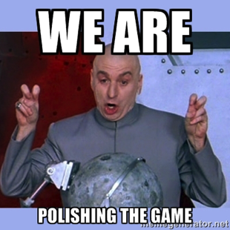
Finishing touches
To-do
Feature freeze 2-3 hours before the deadline
Create a build for submission
Get team together and decide what to polish in the remaining hours
If polishing works out, create a new build for submission

Slide 44
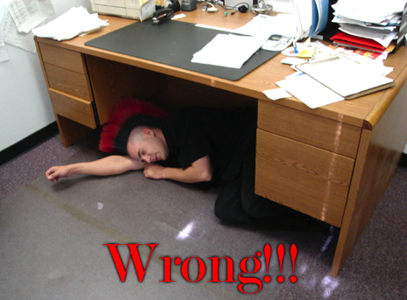
Final Thoughts
Sleep!
Eat & Drink!
Take breaks!
Make new friends!

Slide 45


